Slide 1
KAGR Case Study
Rithvik Donnipadu

Slide 2
Introduction and Objective
The goal of our retention model is to predict whether a customer will renew their tickets or not based on historical data
The primary objective of this model is to assist the basketball team’s ticketing department in identifying customers at risk of non-renewal and enable proactive retention strategies to improve renewal rates.

Slide 3
Initial Data Analysis
We have two datasets:
Customer Details with 4 columns and 3781 observations
Renewal Details with 16 columns and 3781 observations
Did imputation for NULL values
Converted columns like ‘Renewal_or_Non-renewal_Date’ into Date type format
Performed one hot encoding on categorical columns
Dropped columns like ‘Customer_ID’ and ‘Previous_Season’ which did not provide a lot of information for making predictions

Slide 4
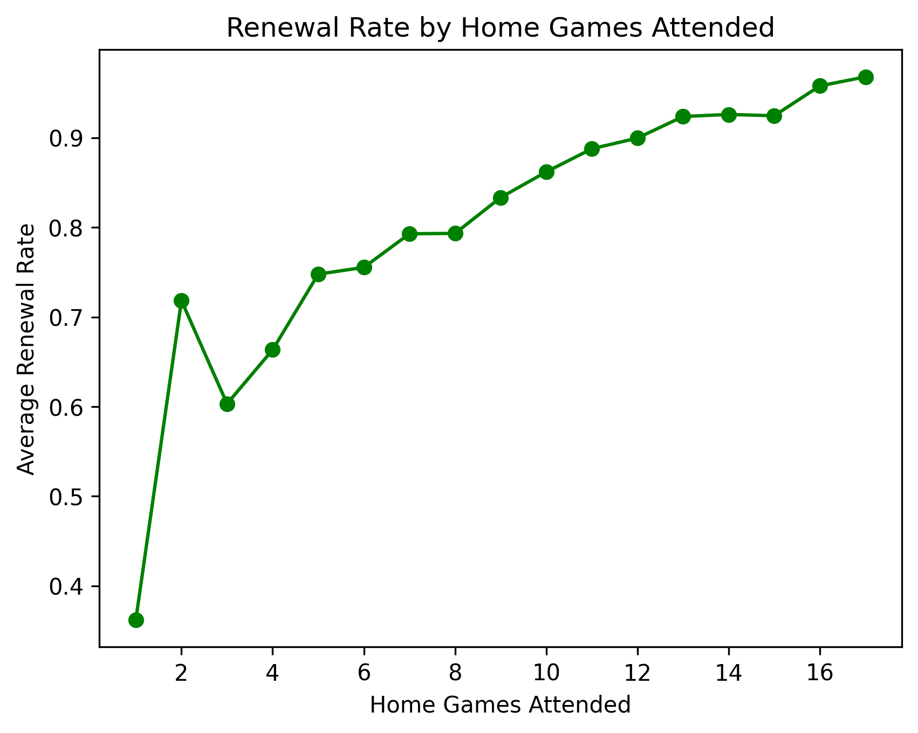
Key Features
On performing EDA, few features seemed to be highly related to Renewals. We show a few of them here
1.Games_Attended_Previous_Season
2. Renewal_Month
3. Tenure_As_Season_Ticket_Member

Slide 5
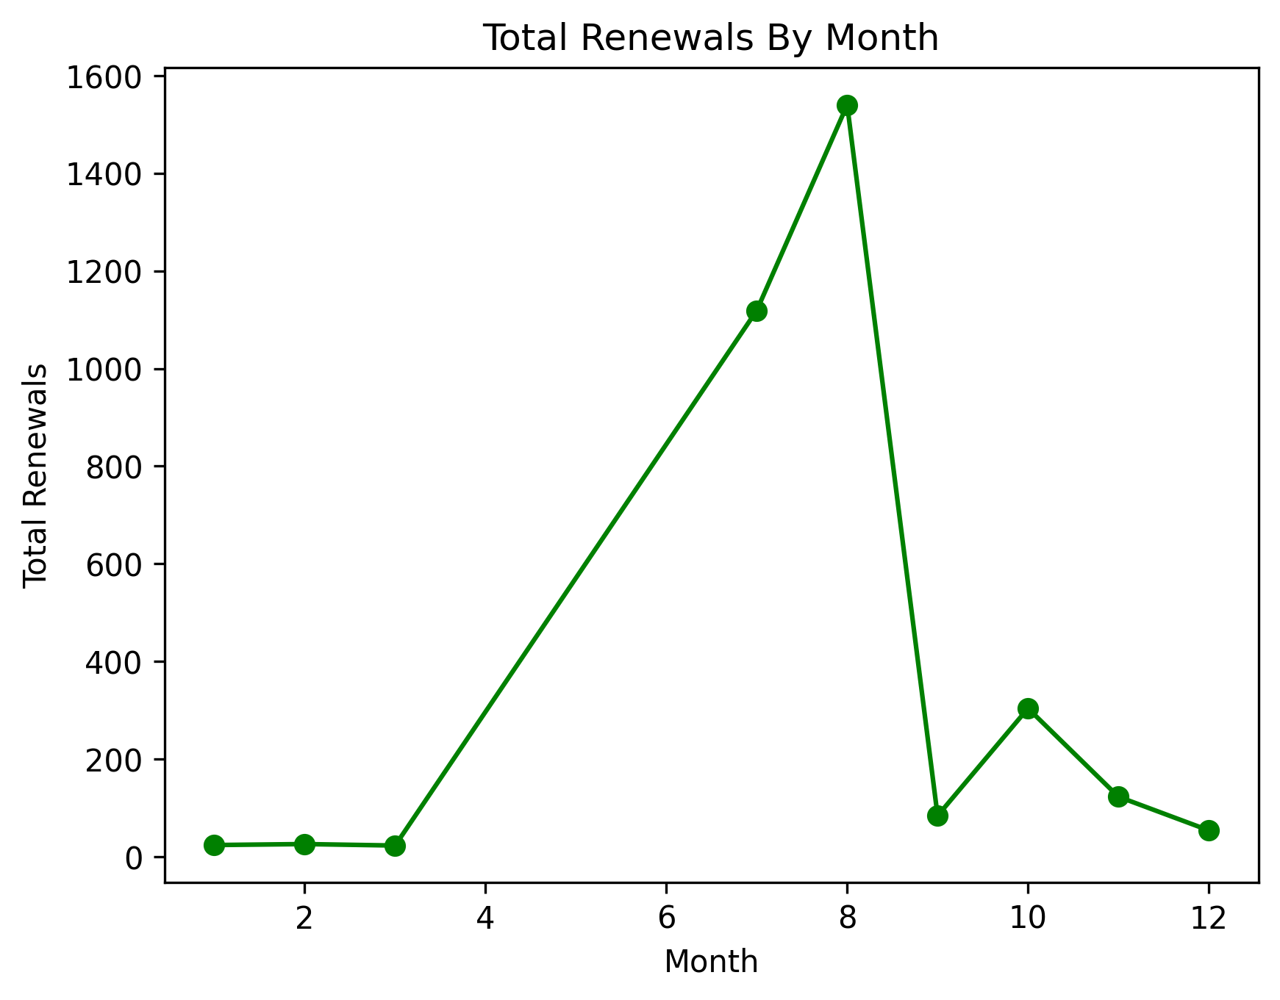
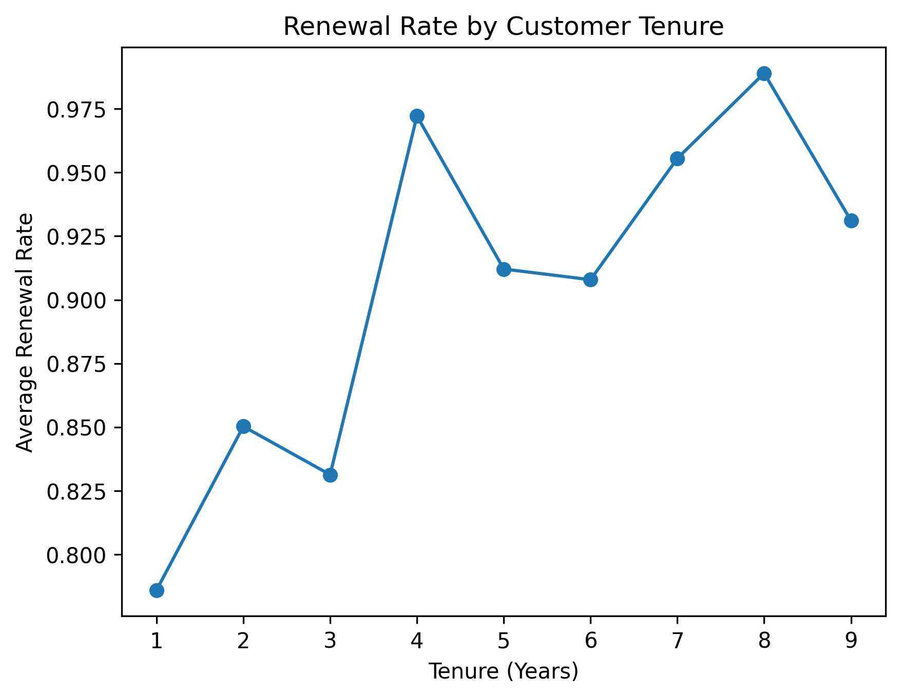
Key Features

Slide 6
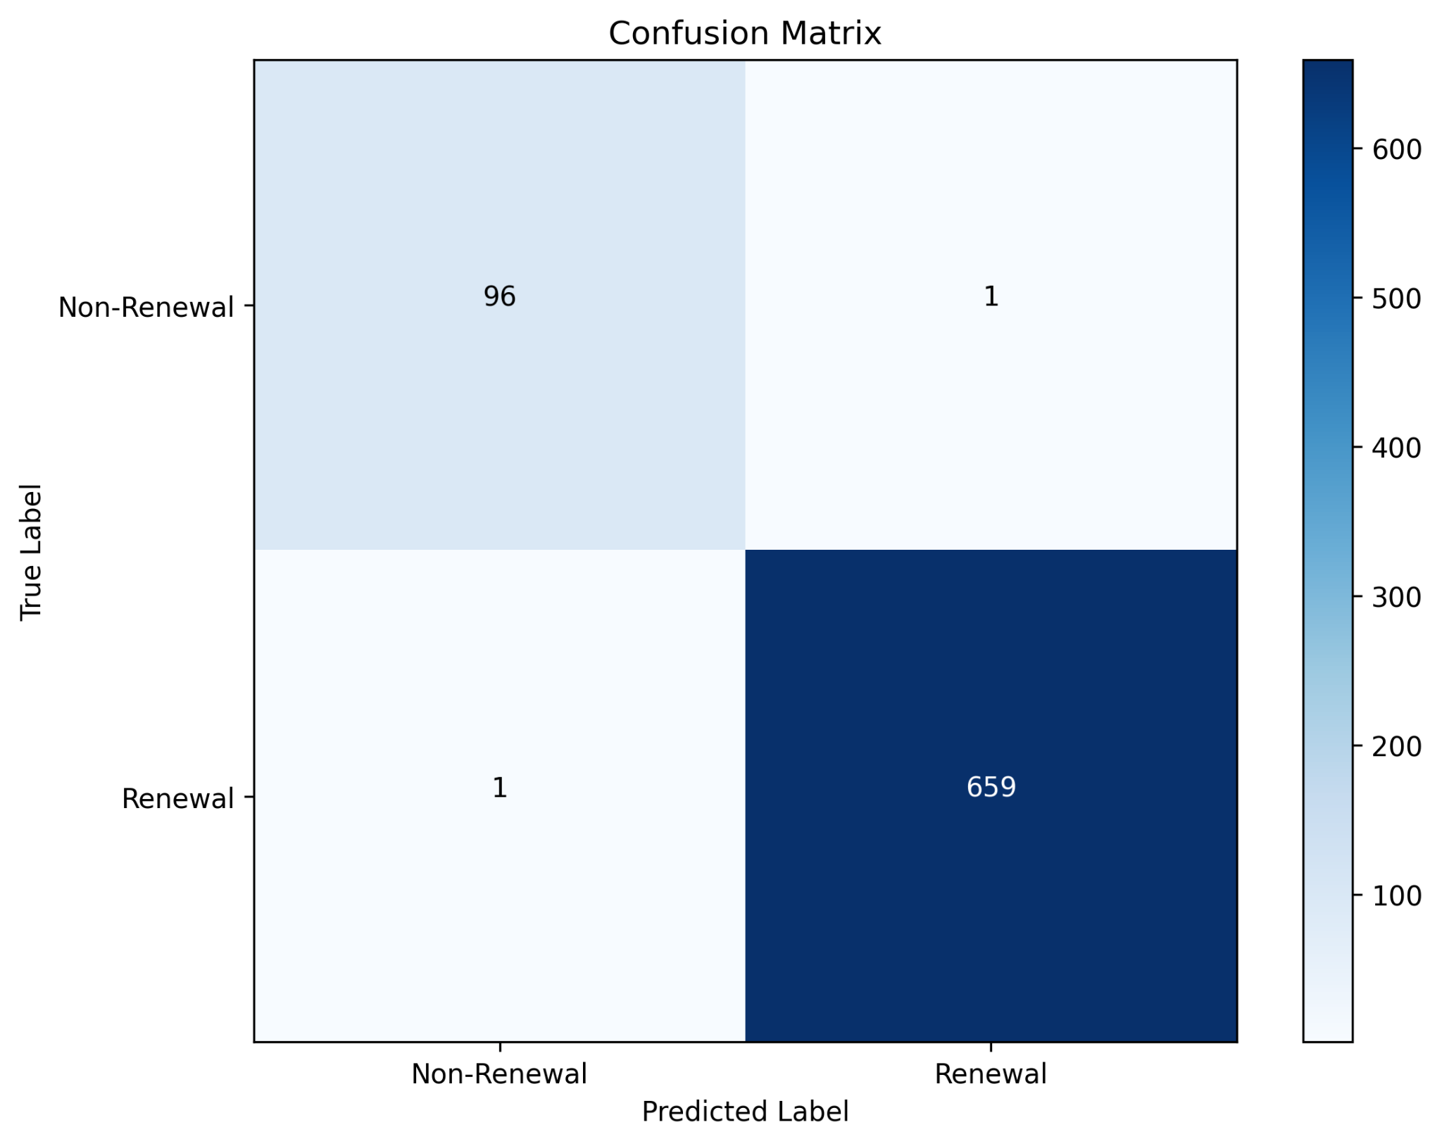
Modelling
Using Renewals as a target variable, we selected Random forest from a bunch of candidate models and performed hyperparameter tuning to enrich its predictive power.
Evaluated the model performance using AUPRC, Confusion matrix and F1 Score

Slide 7
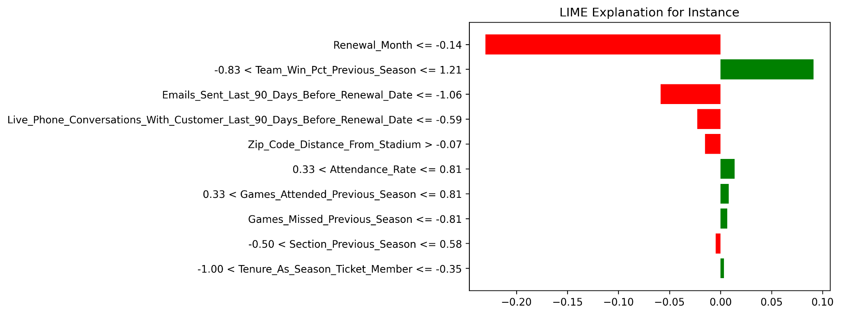
For a given observation, the LIME plot shows that renewals is highly dependent on renewal month, followed by team performance and communication by the outreach team
Tenure and games attended are also of relevance here.

Slide 8
Recommendations
Customers with a high tenure and high game attendance are more likely to renew
Looks like month of renewal plays an important role (seasonal effect), and targeting renewals in those months can have a huge turnover
Outreach via email and calls seems to negatively impact renewals. Care must be taken to selectively reach out to customers to prevent unwanted churn

